Slide 1
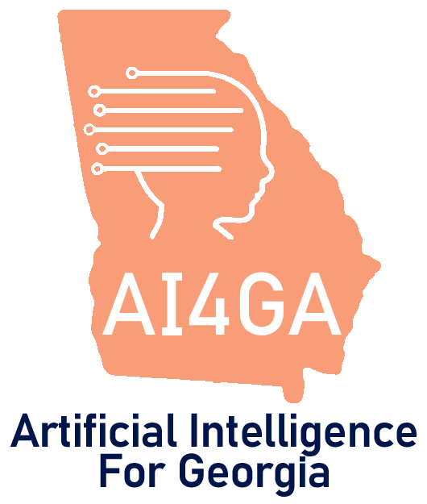
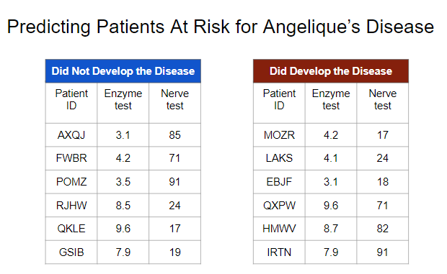

Unit 3 Accelerated Activities
Activity: Angelique’s Disease using Machine Learning for Kids
Living and Working with Artificial Intelligence
Developed for the AI4GA (Artificial Intelligence for Georgia) project funded by National Science Foundation awards DRL-2049029 and DRL-2048502.
This work is licensed under the Creative Commons. Attribution-NonComercial-ShareAlike 4.0 International License. https://creativecommons.org/licenses/by-nc-sa/4.0/

Slide 2
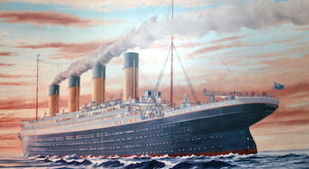
Unit 3 Accelerated Activities
Activity: Titanic Survival Dataset Exploration using Machine Learning for Kids
Living and Working with Artificial Intelligence
Developed for the AI4GA (Artificial Intelligence for Georgia) project funded by National Science Foundation awards DRL-2049029 and DRL-2048502.
This work is licensed under the Creative Commons. Attribution-NonComercial-ShareAlike 4.0 International License. https://creativecommons.org/licenses/by-nc-sa/4.0/

